Slide 1
Legislative Virtual Participation Guide
2022 General Session
Notes:
………………..
I had a lot of fun putting this together, I’m not sure how familiar you are with the legislature website or the bill process in general, so I hope that this goes into enough detail without getting too technical. Please ask questions if I’m going too fast or if you’d like me to go to the website itself and show you how to navigate that way.

Slide 2
LEGISLATIVE PROCESS
Notes:
LEGISLATIVE PROCESS OVERVIEW
TO NAVIGATE THE WEBSITE YOU NEED TO KNOW THE PATH A BILLS TAKES IN THE STATE SO I’LL PROVIDE A BRIEF OVERVIEW
KEEP IN MIND THERE ARE LIKE A MILLION WAYS TO ACCESS THE SAME THING IN THE WEBSITE SO THIS IS SIMPLIFIED

Slide 3
LEGISLATIVE PROCESS
1
2
3
REQUESTED
NUMBERED
1st READING
4
5
6
2ND READING
3RD READING
SIGNED
Bill is drafted, LRGC fills request, sponsor approves
H.B – ‘House Bill’
S.B. – ‘Senate Bill’
Bill introduction on the floor, committee assignment
Approving committee report, a formality
Floor debate, substitution, amendment, and vote
Governor’s signature (adoption into UT Code), or Veto
Notes:
1. BILL IS DRAFTED BY LEGISLATORS, SUBMITTED TO LRGC. LRGC FILLS REQUESTS AND ATTORNEYS PERFORM CONSTITUTIONAL ANALYSIS, LEGISLATIVE REVIEW NOTE ATTACHED. DURING THIS TIME THE LFA ISSUES A FISCAL NOTE, BASICALLY A STATEMENT OF FISCAL IMPACT. THE DRAFTED BILL IS SENT BACK FROM LRGC TO SPONSOR FOR APPROVAL, THIS IS USUALLY A BACK-AND-FORTH WITH MULTIPLE SETS OF REVISIONS.
2. ONCE APPROVED BY THE SPONSOR, THE BILL IS NUMBERED
3. 1ST READING IS THE BILL INTRODUCTION
MEANING IT IS ANNOUNCED ON THE FLOOR OF THE ORIGINATING CHAMBER AND THE RULES COMMITTEE ASSIGNS IT TO A STANDING COMMITTEE BASED ON THE SUBJECT MATTER
LEGISLATORS CONVINCE COMMITTEE CHAIRS TO PLACE THEIR BILL ON A COMMITTEE AGENDA
IF A BILL IS TABLED, IT IS SENT BACK TO RULES, WHICH USUALLY KILLS THE BILL
A BILL CAN BE HELD ON THE COMMITTEE AGENDA
IT CAN BE CIRCLED ON THE READING CALENDAR TO POSTPONE DEBATE
IT CAN BE TABLED, WHICH REQUIRES VOTE TO UNTABLE
COMMITTEES REVIEW, SUBSTITUTE, AMEND, AND RECOMMEND THE BILL
4. 2ND READING IS FLOOR APPROVAL OF THE COMMITTEE REPORT
ONCE A BILL HAS BEEN FAVORABLY RECOMMENDED BY A COMMITTEE IT IS SENT TO THE ORIGINATING BODY FLOOR TO APPROVE THE REPORT AND PUT IT ON THE 2ND READING CALENDAR
5. 3RD READING
THIS IS THE ACTUAL VOTE ON THE FLOOR
DEBATE, SUBSTITUTE, AMEND
IF PASSED, IT IS THEN SENT TO OPPOSITE CHAMBER 1ST READING TO CONTINUE THE SAME PROCESS AND MEET FINAL VOTE
* CONSENT CALENDAR MEANS IT IS FAST TRACKED
6. GOVERNOR’S SIGNATURE/VETO
IF SIGNED, IT IS ADOPTED INTO THE UTAH CODE

Slide 4
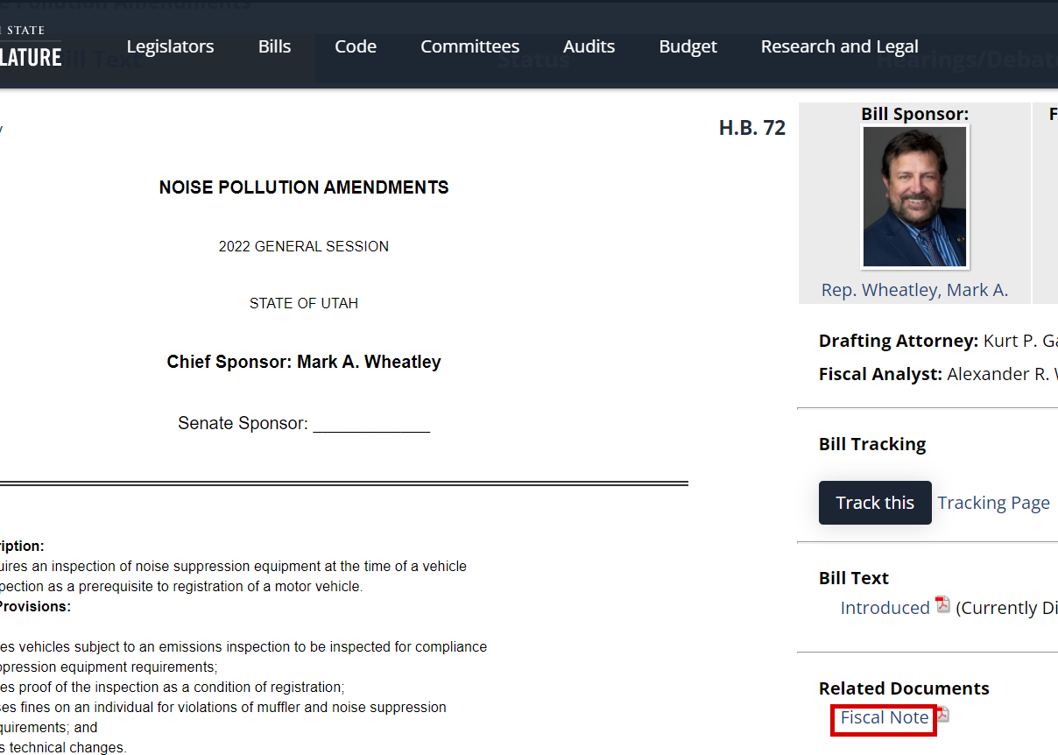
LEGISLATIVE PROCESS
FISCAL NOTE
Notes:
THROUGHOUT THE PROCESS, LFA ISSUES A FISCAL NOTE, BASICALLY A STATEMENT OF FISCAL IMPACT

Slide 5
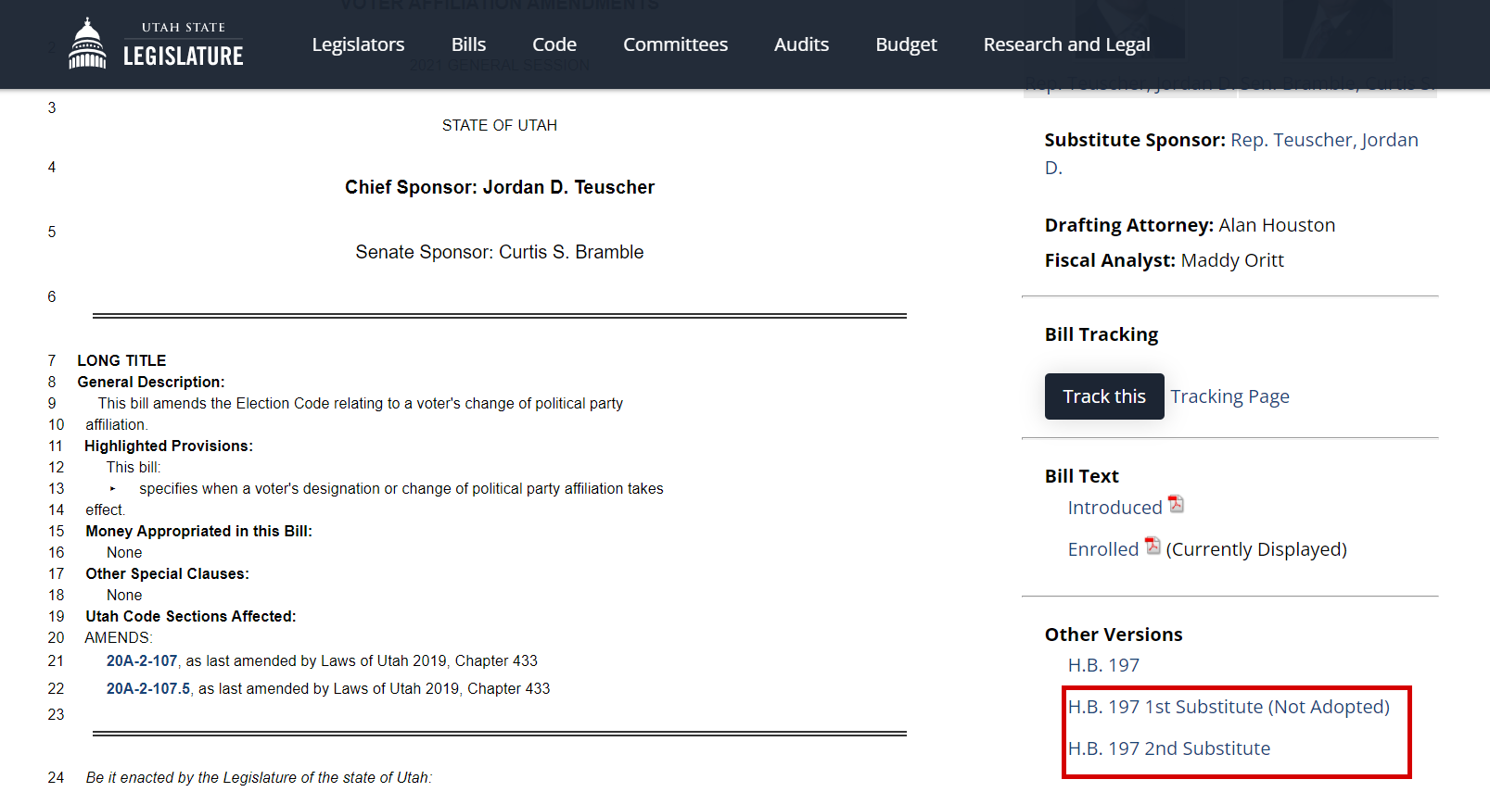
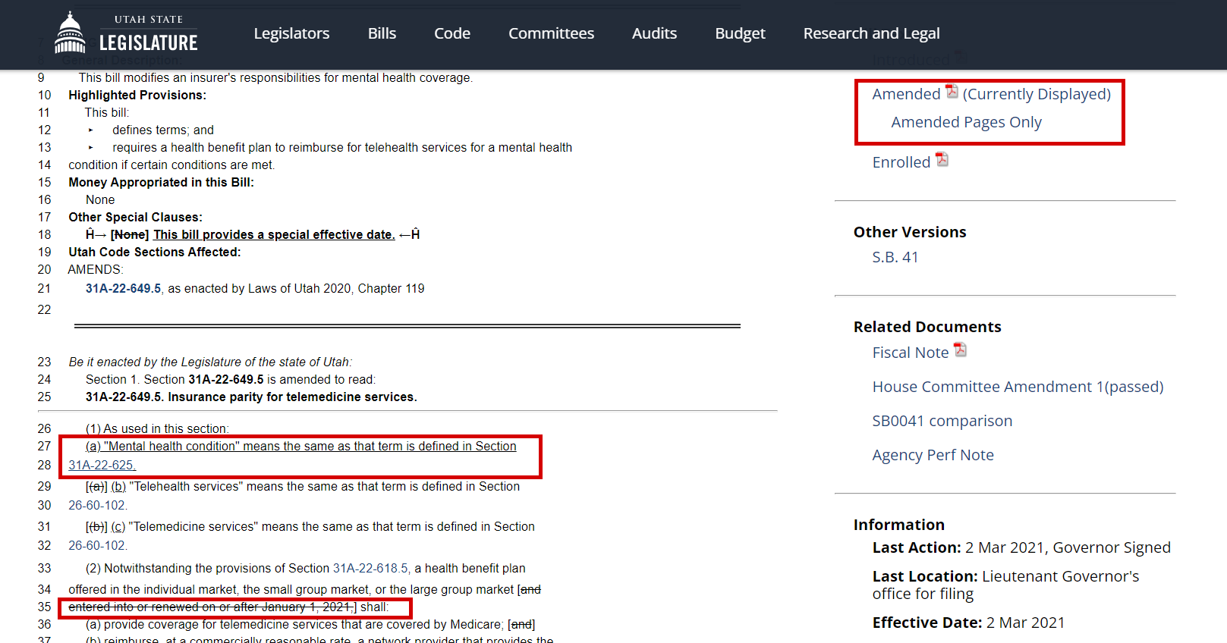
LEGISLATIVE PROCESS
SUBSTITUTE
AMENDMENT
Notes:
Bills can be substituted or amended anywhere in the process, so this is helpful to know if you are watching a hearing or a floor debate to know what version they are considering. Often substitutes are numbered before the HB or SB, so here it would look like 1HB 197 or 2HB 197. If you click on these you can compare the substitutes with the original bill.
When reading a bill or an amended bill, you can also compare and read through the additions or strikethroughs it makes to the Utah Code.

Slide 6
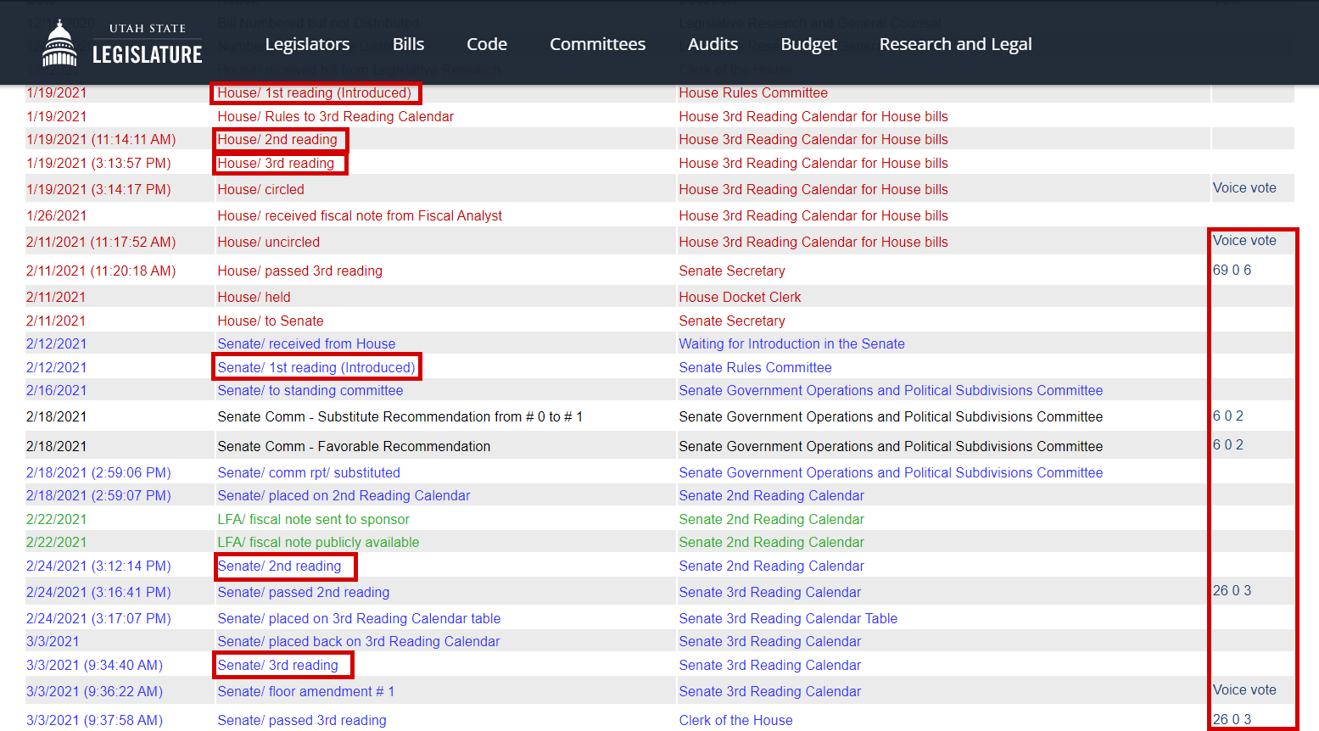
LEGISLATIVE PROCESS
Vote Detail
Notes:
This is under the bill status tab, showing when the bill was placed on each reading calendar and the actions (substitutes, amendments, tabling, holding, etc.) taken
Here you can also select the vote detail, which, if it isn’t a voice vote, will show you who voted for and against

Slide 7
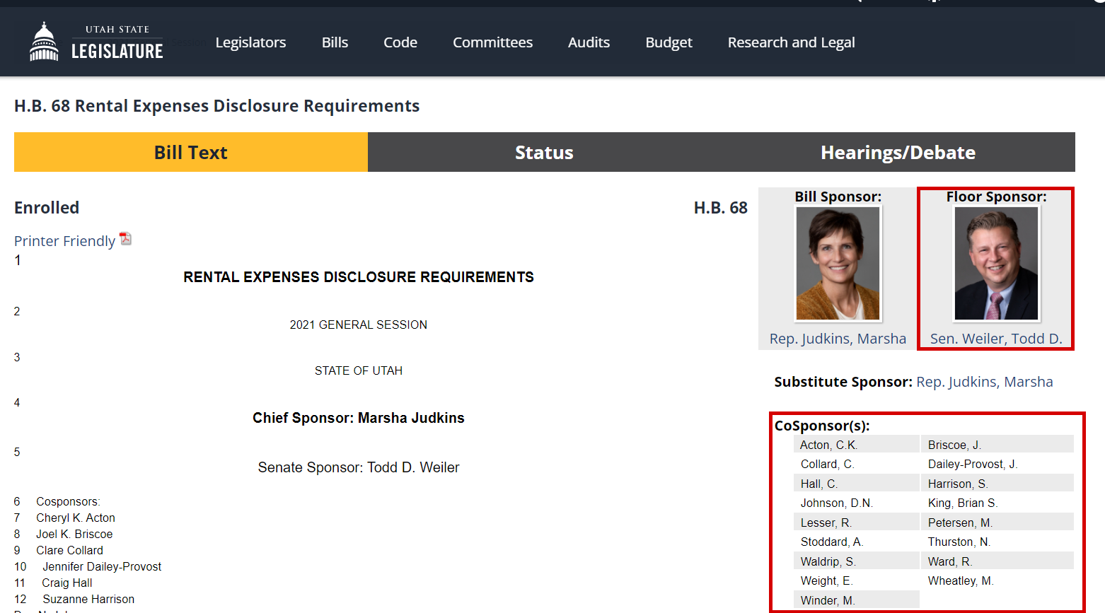
LEGISLATIVE PROCESS
FLOOR SPONSOR
COSPONSORS
Notes:
AT ANY POINT IN THIS PROCESS THE BILL SPONSOR SEEKS A FLOOR SPONSOR (REQUIRED) TO PRESENT THE BILL IN THE OPPOSITE CHAMBER AND CO-SPONSORS IN THEIR OWN CHAMBER (OPTIONAL) TO GATHER SUPPORT

Slide 8
BILL TRACKING

Slide 9
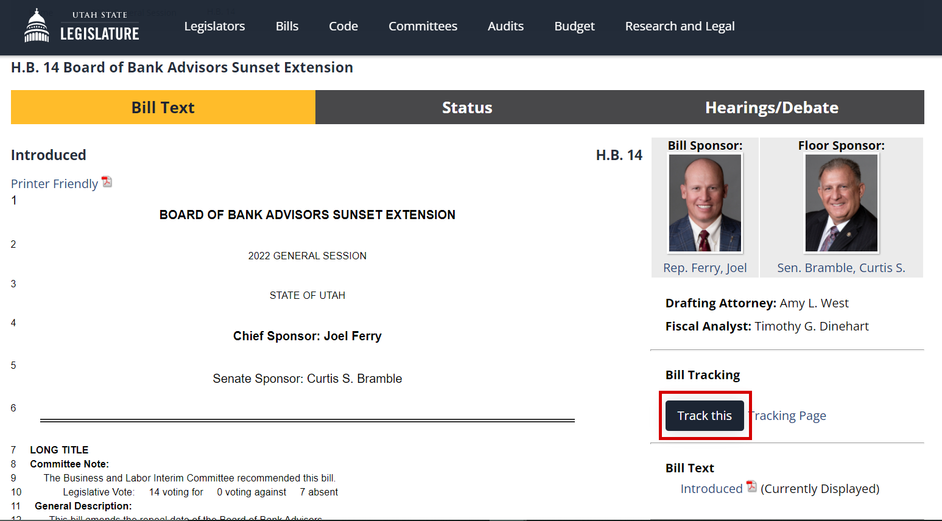
BILL TRACKING
Individual Bills
Bills ->
View Bills ->
Track this
Notes:
MULTIPLE WAYS TO SIGN UP FOR TRACKING
TRACK THIS BUTTON FOR INDIVIDUAL BILLS

Slide 10
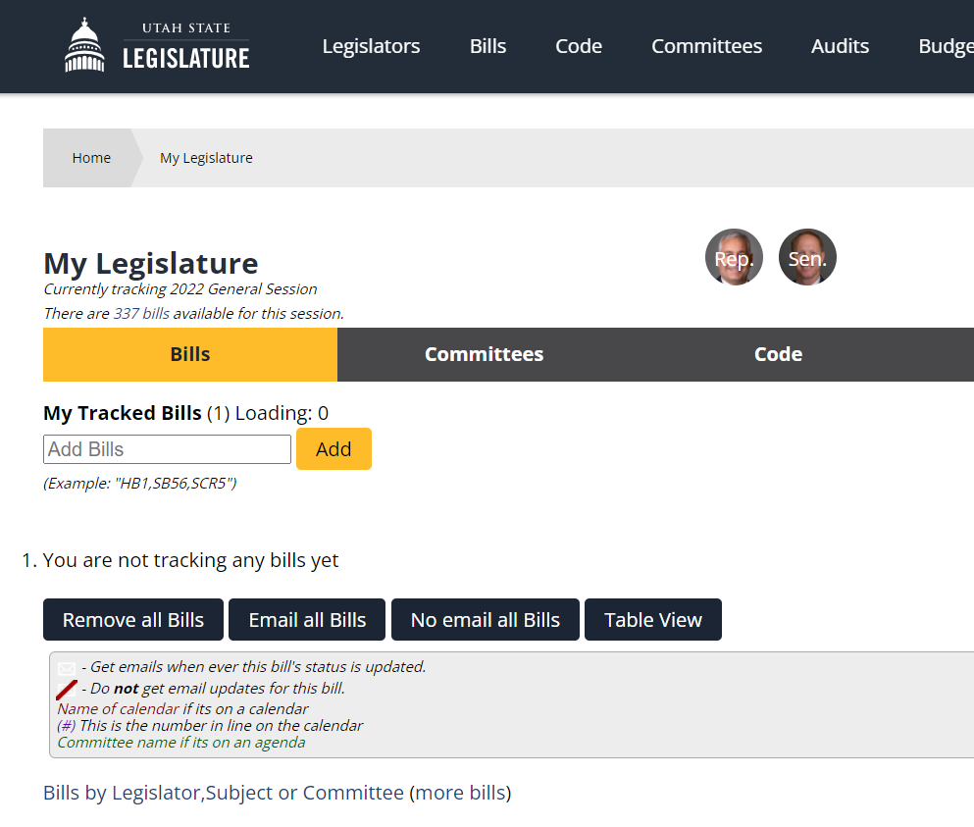
BILL TRACKING
Tracking Page
Bills ->
View Bills ->
Tracking Page
Notes:
TRACKING PAGE, HERE YOU CAN SIGN UP FOR BILL AND COMMITTEE ACTIVITY TRACKING ON YOUR ACCOUNT. YOU’LL GET NOTIFICATIONS WHEN BILL STATUS HAS CHANGED OR WHEN A COMMITTEE IS IN SESSION OR HAS ISSUED A REPORT, ETC.

Slide 11
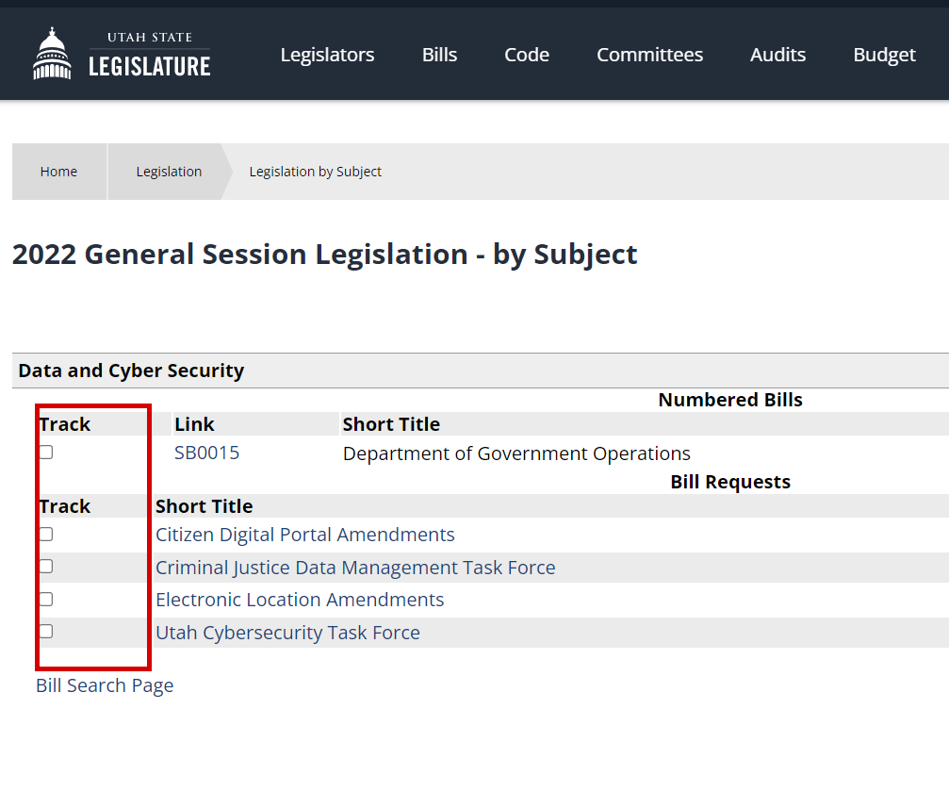
BILL TRACKING
By Subject Or Legislator
Bills ->
Browse By Session ->
Subject/Legislator ->
Track
Notes:
FOR MORE DETAIL, GO TO BROWSE BY SESSION -> SEARCH BY LEGISLATOR, SUBJECT, OR COMMITTEE, YOU CAN ALSO SEE WHAT BILL REQUESTS HAVE BEEN PUT IN FOR YOUR SUBJECT OF INTEREST HERE

Slide 12
FLOOR TIME
Notes:
TUNING INTO FLOOR TIME

Slide 13
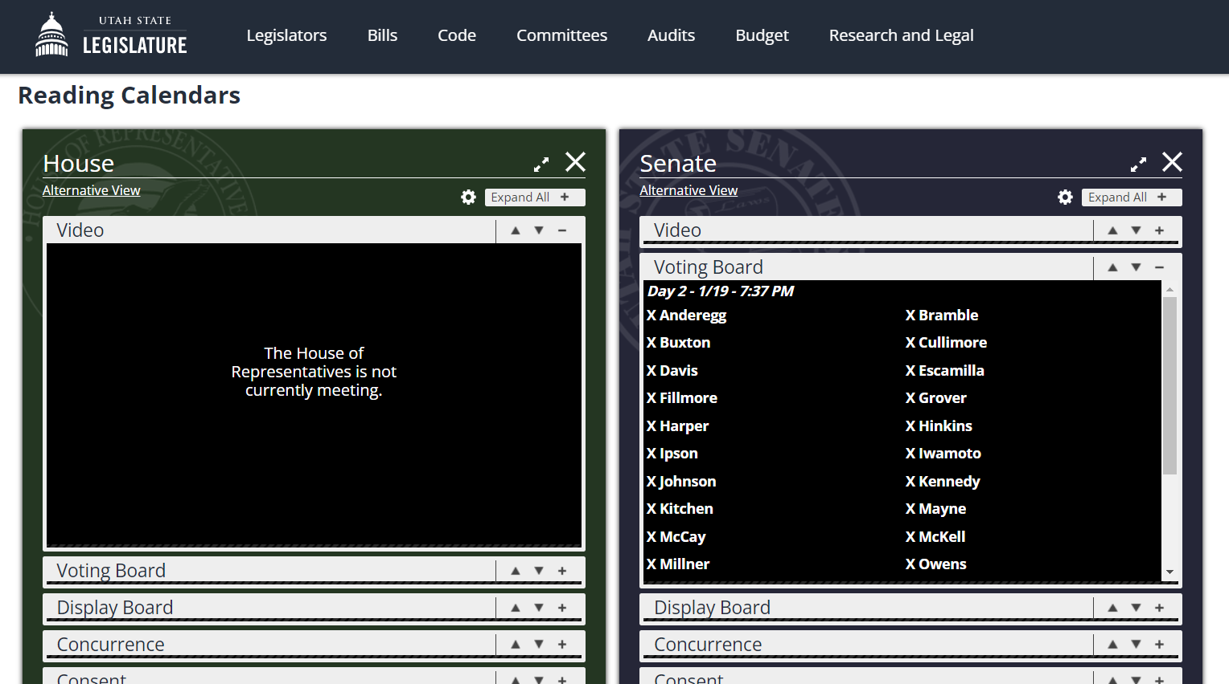
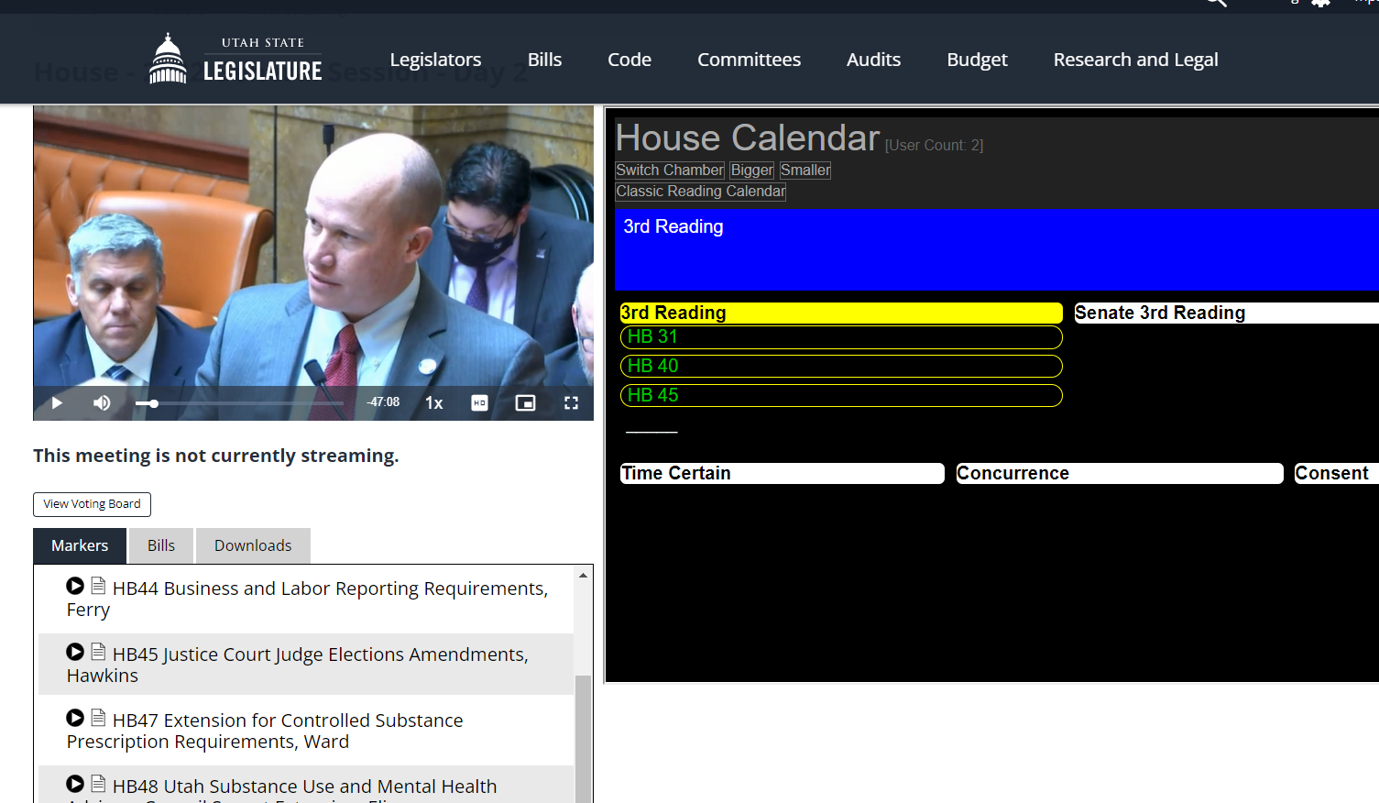
FLOOR TIME
Recordings
Live
Legislators ->
Chamber ->
Past Floor Debates
Legislators ->
All Legislators ->
Reading Calendars
Notes:
HERE YOU CAN SEE THE AGENDA FOR THE DEBATE OF THE RECORDING AS WELL AS THE VOTING BOARD AT THE TIME
YOU CAN SEE THE VIDEO, VOTES, AND AGENDA ON LIVE STREAM AS WELL

Slide 14
COMMITTEE PARTICIPATION
Notes:
COMMITTEE PARTICIPATION
ALL LEGISLATORS ARE ASSIGNED TO APPROPRIATIONS SUBCOMMITTEES, WHICH HANDLE BUDGET APPROPRIATIONS BY SUBJECT MATTER
PERMANENT GENERAL SESSSION COMMITTEES ARE CALLED STANDING COMMITTEES

Slide 15
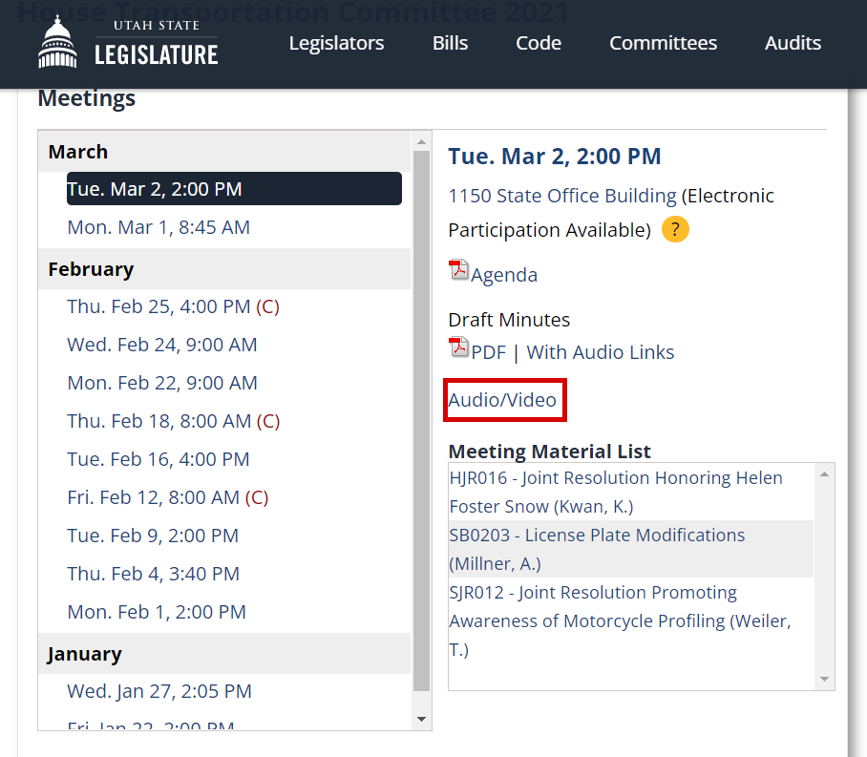
COMMITTEE PARTICIPATION
RECORDINGS
Committees ->
All Committees ->
Committee Page ->
Audio/Video
Notes:
THIS HERE IS A COMMITTEE WEBPAGE. OFTEN AGENDAS ARE POSTED TO SEE WHAT BILLS THE CHAIR HAS PLACED ON THE AGENDA
CAN ALSO SELECT AUDIO VIDEO IF YOU WANT TO WATCH PREVIOUS RECORDINGS

Slide 16
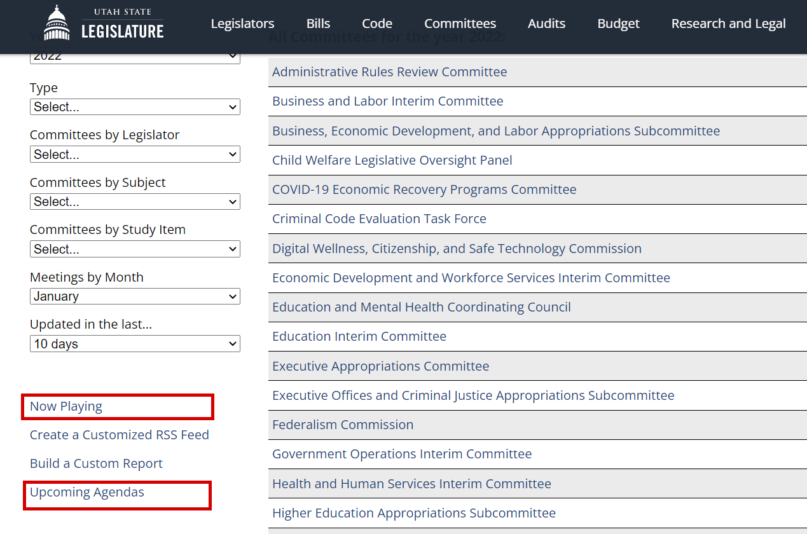
COMMITTEE PARTICIPATION
LIVE
Committees ->
All Committees ->
Now Playing
Or
Upcoming Agendas
Notes:
ALL COMMITTEES -> NOW PLAYING SHOWS ACTIVE MEETINGS
UPCOMING AGENDAS WILL SHOW YOU THE DAILY COMMITTEE SCHEDULES

Slide 17
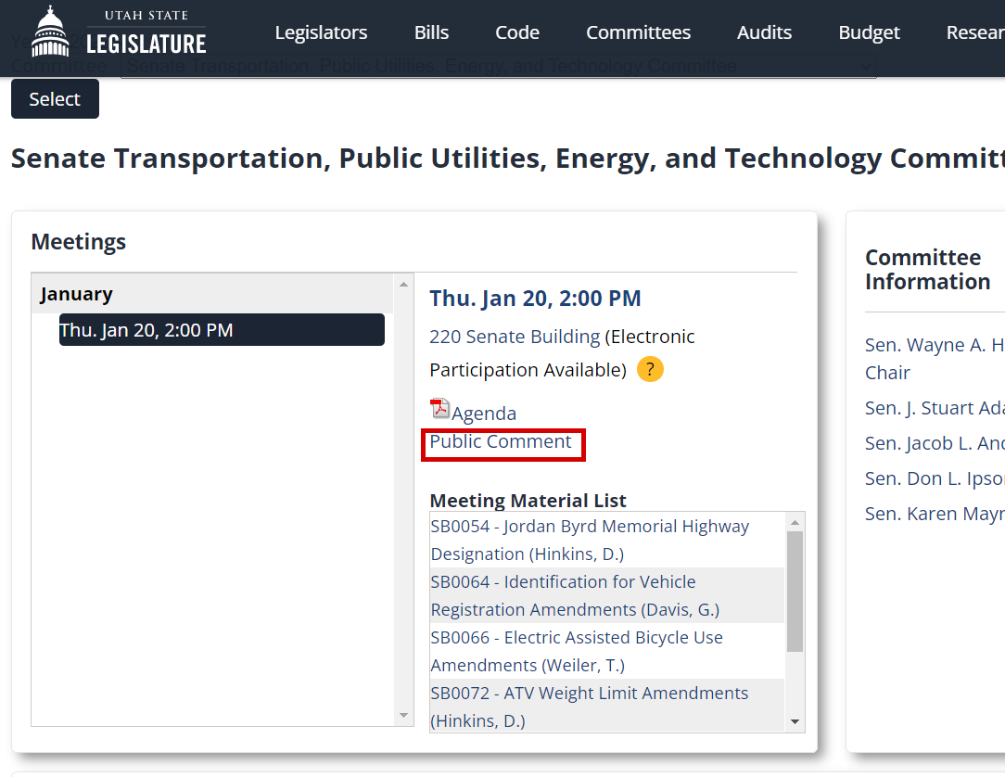
COMMITTEE PARTICIPATION
PUBLIC COMMENT
1
2
Sign Up
Access
Committees ->
All Committees ->
Committee Page ->
Public Comment
Committees ->
All Committees ->
Committee Page ->
Participate in Virtual Meeting
Notes:
JUST VIEWING THE MEETING LIVE STREAM IS DIFFERENT FROM PROVIDING PUBLIC COMMENT, WHICH MEANS YOU PROVIDE INPUT TO THE COMMITTEE ON A BILL DURING THE HEARING. SIGNING UP FOR PUBLIC COMMENT HELPS SECURE A SPOT TO SPEAK, TO DO SO, YOU WILL GO TO COMMITTEE PAGE -> PUBLIC COMMENT TO SIGN UP, AND TO ACCESS THE MEETING ONCE YOU’VE SIGNED UP, GO TO COMMITTEE PAGE -> PARTICIPATE IN VIRTUAL MEETING. IT WILL BE ON ZOOM SO YOU’LL RAISE YOUR HAND.

Slide 18
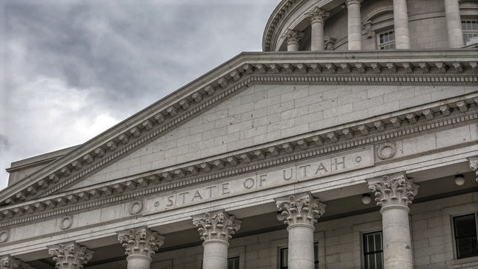
QUICK LINKS
Signing Up to Comment:
https://le.utah.gov/how2PublicComment.html
Accessing Hearings:
https://le.utah.gov/Documents/VirtualMeetingInstructions.pdf
Live Debates:
https://le.utah.gov/FloorCalendars/
Past Debates:
https://le.utah.gov/asp/audio/index.asp?Sess=2022GS&Day=2&Bill=&House=H
Notes:
And just for reference here are some quick resource links to the pages mentioned in this guide.
Any questions?

